Slide 1
Intermediate Presentation Bachelor Thesis Deep embedded Music Fabian Gröger
21.04.2020
Notes:
Welcome Mister Callner, Mister Daly, Mister Lionetti, Mister Oehri and Mister Pfäffli
Introduce myself
Introduce the presentaiton

Slide 2
Agenda
Project overview
Project management
Related Work
Datasets used
Ideas and concepts
First results
Summary and outlook
Q&A
Notes:
To start of I’m going to show you the agenda for today
As you can see we have quite a lot ahead of us, so I will start right away

Slide 3
Project Overview: Unsupervised embedding space for audio
Idea
Create an embedding space for audio, using unsupervised machine learning
Adapt Tile2Vec, an image embedding algorithm, to audio
Evaluate the performance on the DCASE 2018 task 5 dataset
Train a simple classifier on the embeddings
The resulting embedding algorithm should be applied exploratively to music
To-Do
Adapt Tile2Vec algorithm to music with Tensorflow 2.0
Find an appropriate audio feature to represent the samples
Find an embedding architecture based on neural networks
Evaluate the architecture on a music dataset
Notes:
In recent years there were quite some advances in the audio domain by successfully adapting image processing architectures to audio
But they have one big catch; they require a lot of supervised training data which is only sparsely available in this domain
To mitigate that problem, a lot of research in recent years focuses on the unsupervised setting within the audio
And that is exactly what my project focuses on

Slide 4
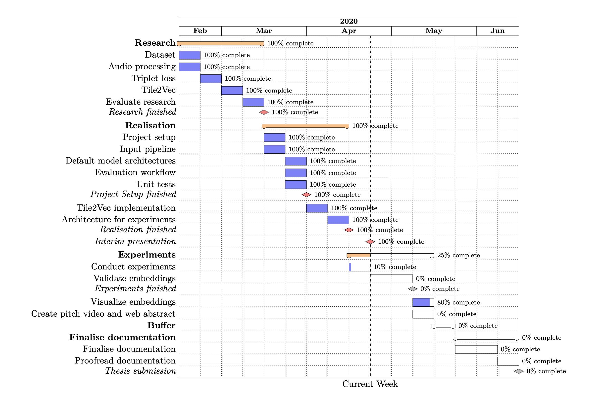
Project Management
Fig. 1 Project plan
Notes:
Project management wise I have chosen a rather simple waterfall model which was adapted to my project
Four phases including a buffer phase
Phases are illustrated with orange, work packages in blue and milestones in red
And the dotted line shows the current week
As you can see, I have already finished the research as well as the realisation phase and started this week with the experiments

Slide 5
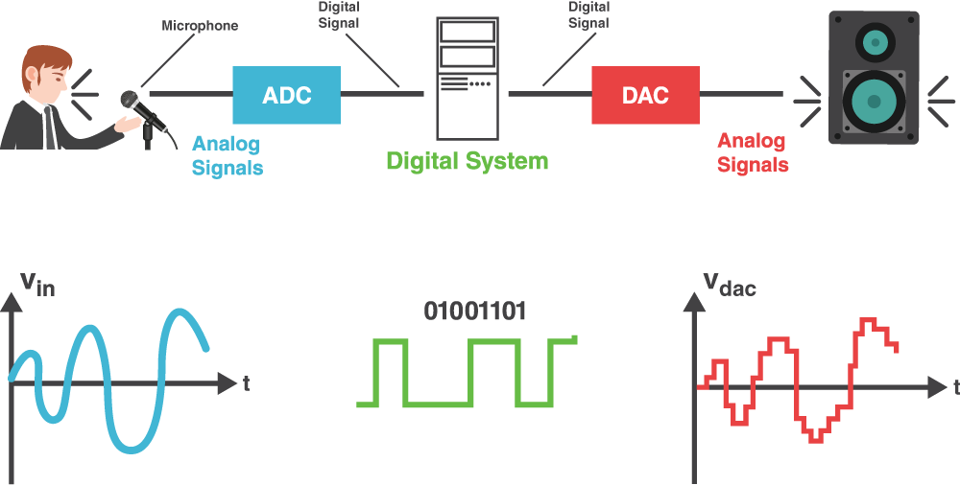
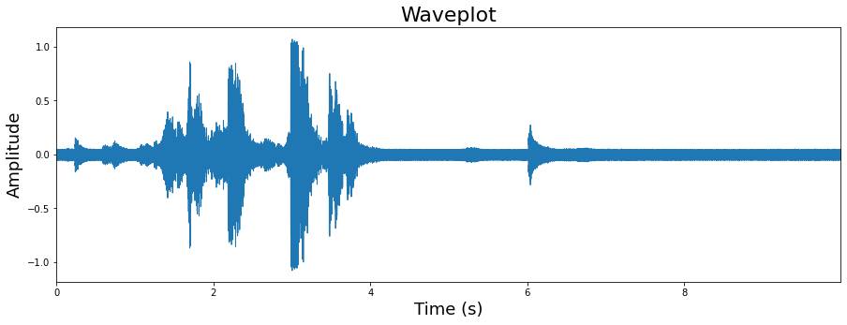
Related Work: Intro to Digital Signal Processing
Digital Signal Processing (DSP) takes a real-world signal which has been digitised and mathematically manipulates it
Sound signals can be defined as pressure variations travelling through the air, which are often referred to as sound waves
Raw waveform: representations of a signal in the time-domain x-axis: represents time y-axis: represents amplitude
Spectrogram: visual representation of the spectrum of frequencies of a signal as it varies with time x-axis: represents time y-axis: represents frequency colours: magnitude of the frequency at a time
Fig. 2 DSP illustration
Fig. 3 Waveplot
References: [1] [2]
Notes:
My project focuses on the working with audio and sound data; therefore I will give you a short introduction to DSP only to clarify some basic terminology which will be used throughout the presentation
Signals need to be processed so that the information they contain can be analysed
Converters such as an Analog-to-Digital converter (ADC) and Digital-to-Analogue (DAC) take a real-world signal and turns it into a digital format and vice-versa
Sound signals can be defined as pressure variations travelling through the air, which can be described as waves and therefore often called sound waves

Slide 6
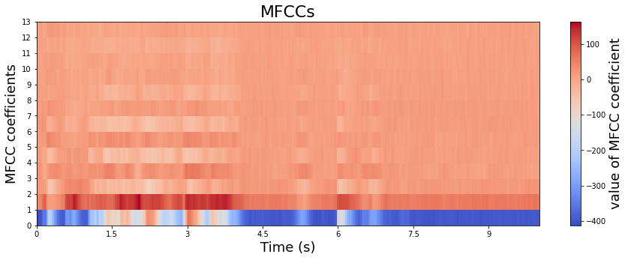
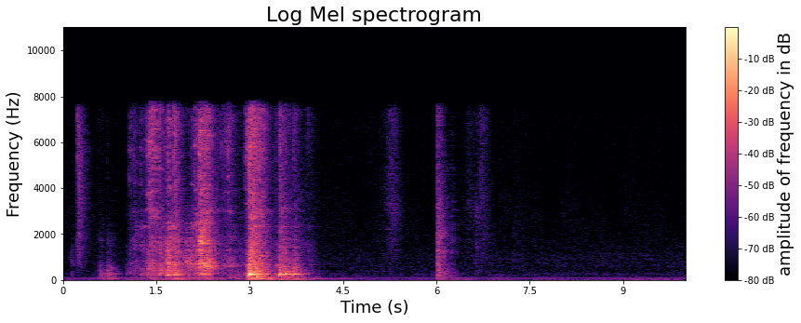
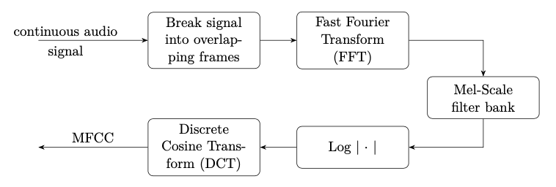
Related Work: Intro to Digital Signal Processing
Mel Frequency Cepstral Coefficients (MFCC) focus on the audio signal and discard information such as background noise
MFCC were designed to mimic the human hearing
Log Mel spectrogram: visual representation of the frequencies in the log Mel scale
Fig. 4 Visualisation of MFCC
Fig. 6 Visualisation calculating MFCC
Fig. 5 Log Mel spectrogram
References: [2]

Slide 7
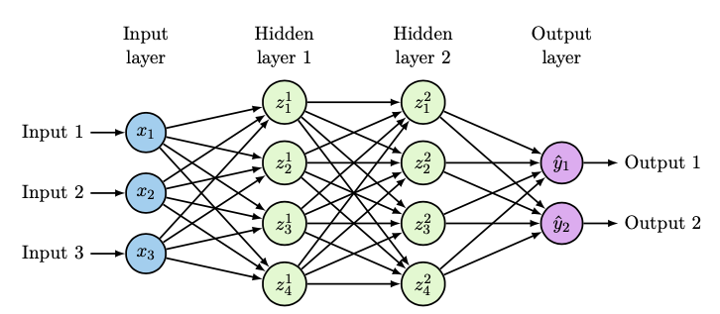
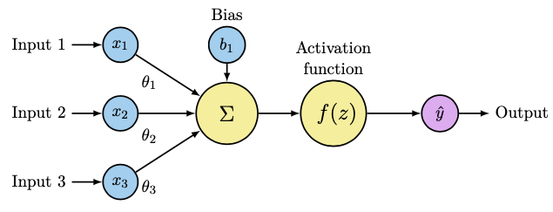
Related Work: Intro to Neural Networks
Artificial Neural Network (ANN or NN) are a computational model which were inspired by the way the brain works
NN consist of many neurons (Perceptron)
Perceptron's consist of input(s), bias and an activation function which are used to calculate an output
Feedforward Neural Networks contain multiple neurons arranged in layers, where each neuron is connected to the adjacent one and information only moves forward
Multi Layer Perceptron (MLP) contain an input, output and one or more hidden layers
Fig. 7 Visualisation of a Perceptron
Fig. 8 Visualisation of an MLP
References: [3]
Notes:
I will just give you a short refresher into NN since I think most of you are probably very familiar with the topic

Slide 8
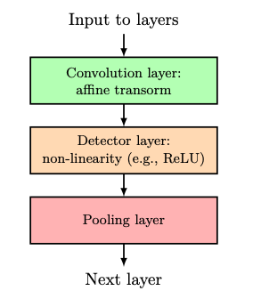
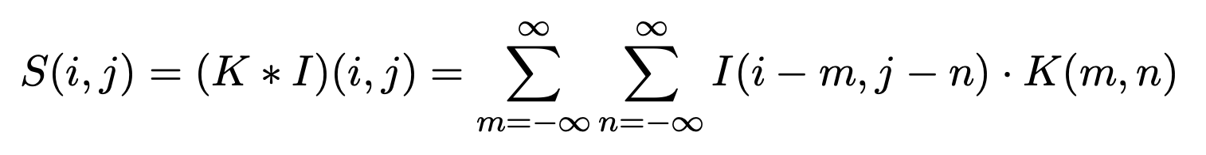
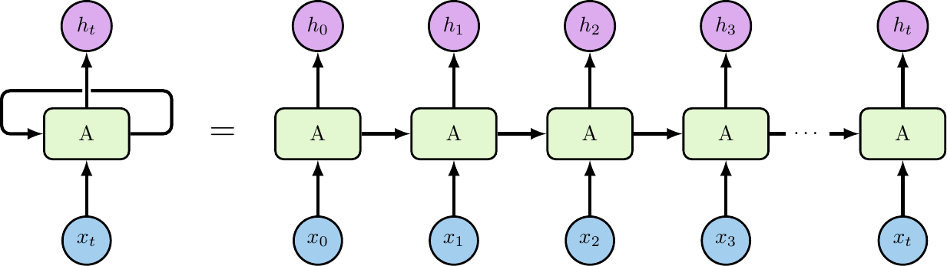
Related Work: Intro to Neural Networks
Convolutional Neural Network (CNN) specialises in working with grid-like data (e.g. sound, images)
CNN are networks that use convolution in place of general matrix multiplication in at least one of their layers
Recurrent neural network (RNN) focus on processing sequential data (e.g. time series)
RNNs use a cyclic loop to pass the information from the step before along with the input of the current step to the next node
Gated Recurrent Unit (GRU) were introduced to solve the vanishing gradient problem in RNNs (input from far behind loses importance)
GRU have two gates, an update and reset gate which decides what information will be passed to the output
Eq. 1 Convolutional operation
Fig. 9 CNN layer structure
Fig. 10 Visualisation RNN
References: [3]

Slide 9
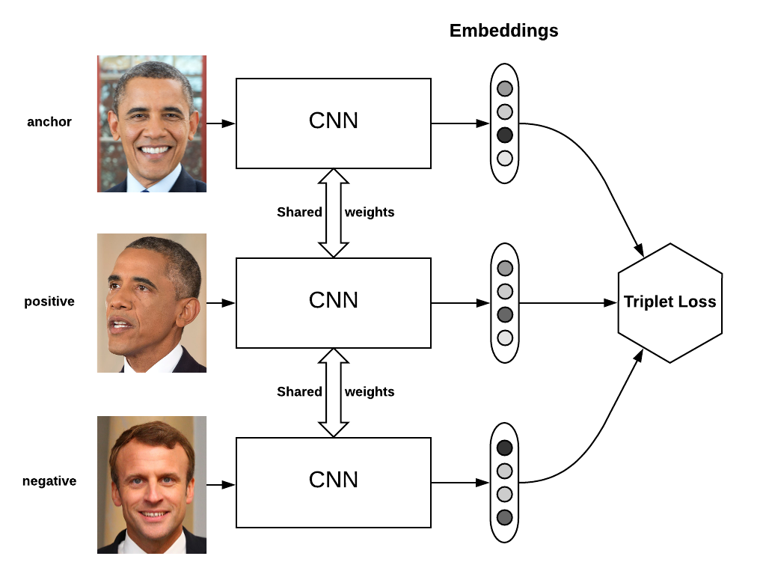
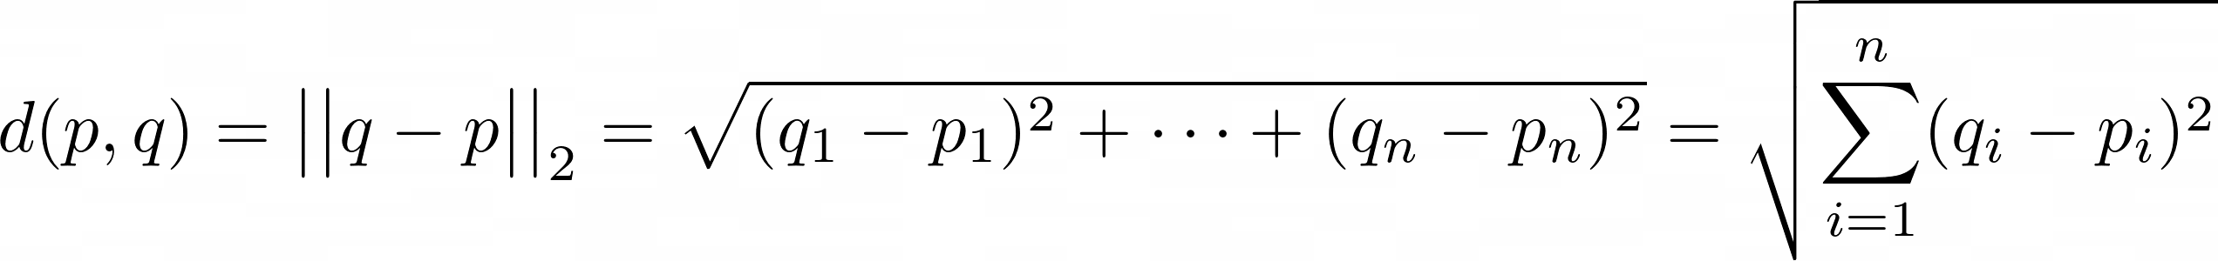
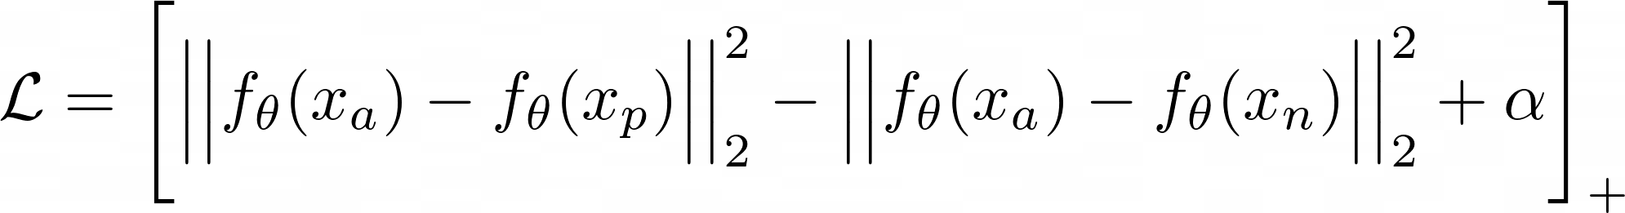
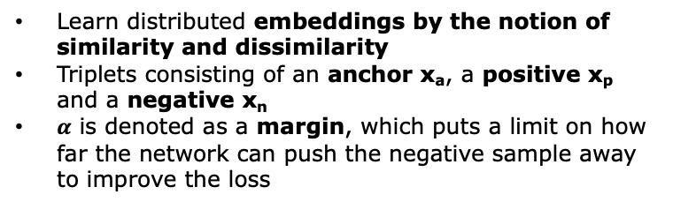
Related Work: Triplet Loss
Learn distributed embeddings by the notion of similarity and dissimilarity
Triplets consisting of an anchor x_{a}, a positive x_{p} and a negative x_{n}
$α$ is denoted as a margin, which puts a limit on how far the network can push the negative sample away to improve the loss
Eq. 2 Euclidian distance
Fig. 11 Triplet loss visualisation
Eq. 3 Triplet loss
References: [4] [5]
Notes:
Introduced by Google for face recognition
positive sample is similar to the anchor and negative one is dissimilar to the anchor
notation [⋅]+ to represent a rectifier, max(0,⋅)
Siamese networks are trained, which share their weights, on triplets
Usually in supervised learning we have a fixed number of classes. However in some cases we need to be able to have a variable number of classes. In face recognition for instance, we need to be able to compare two unknown faces and say whether they are from the same person or not.

Slide 10
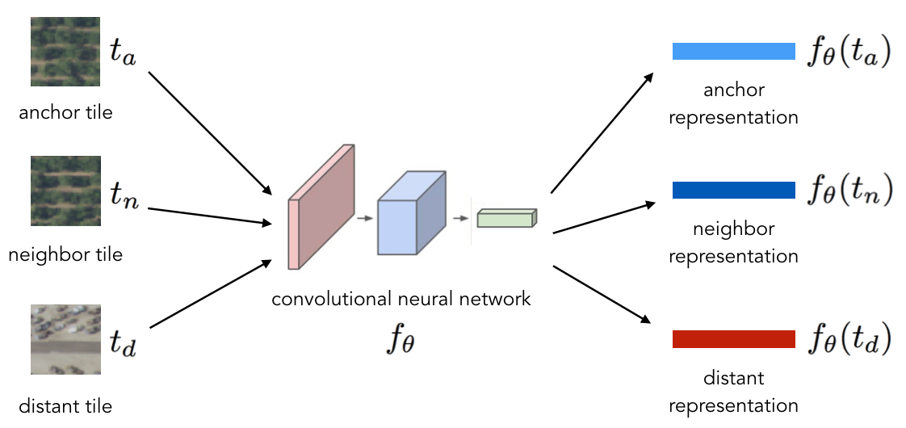
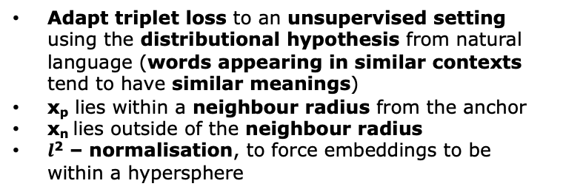
Related Work: Tile2Vec
Adapt triplet loss to an unsupervised setting using the distributional hypothesis from natural language (words appearing in similar contexts tend to have similar meanings)
x_{p} lies within a neighbour radius from the anchor
x_{n} lies outside of the neighbour radius
$l$² – normalisation, to force embeddings to be within a hypersphere
Fig. 12 Visualisation Tile2Vec
References: [6] [7]
Notes:
The idea of triplet loss is very interesting but there is one catch for using it for my project, it assumes supervised data for triplet selection
To tackle that problem, Tile2Vec was introduced by Stanford University

Slide 11
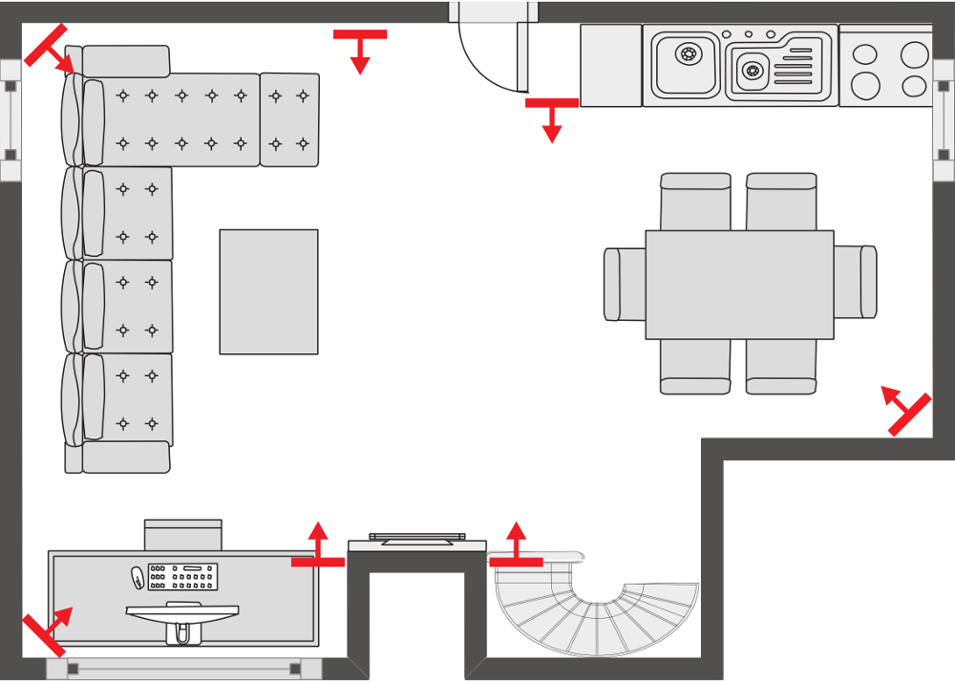
Datasets used: DCASE Challenge 2018 – Task 5 dataset
Derivative of the SINS dataset, a continuous recording of one person living in a vacation home over one week
DCASE: 7 microphone arrays (4 linearly arranged) in the combined living room and kitchen
Continuous recordings were labelled and split into audio segments of 10s
As development set, approximately 200 hours of data from 4 microphone arrays
As evaluation set, data is provided from all the microphone arrays
Winner: IBM Team, macro-averaged F1 score of 88.4%
Fig. 13 DCASE microphones distribution
References: [8]
Notes:
Two different datasets are used within the project, the dcase dataset which further referred to as the noise detection dataset and the music dataset
Segments containing more then one active class (e.g. a transition of two actitivies) were left out! This means that each segments represents one activity
As evaluation set, data is provided from all the sensor nodes (i.e. also sensor nodes not present in the development set)
The evaluation will be based on the sensor nodes not present in the development set.
The data from the same nodes as in training are provided to give insights about the overfitting on those positions.

Slide 12
Datasets used: Music Dataset
7 different music genres with 30 songs each
Songs classified by genre according to Beatport.com
Approximately 18 hours of music
Songs vary in length, from 3min to 10min
Single channel .mp3 files
Tbl. 1 Music dataset
Music genre | # songs
Deep House | 30
Electronica Downtempo | 30
Indie Dance | 30
Melodic House and Techno | 30
Techno Peak Time Driving Hard | 30
Techno Raw Deep Hypnotic | 30
Trance | 30
Total | 210
Notes:
The second dataset used within my project is the music dataset, kindly provided by mister Oehri

Slide 13
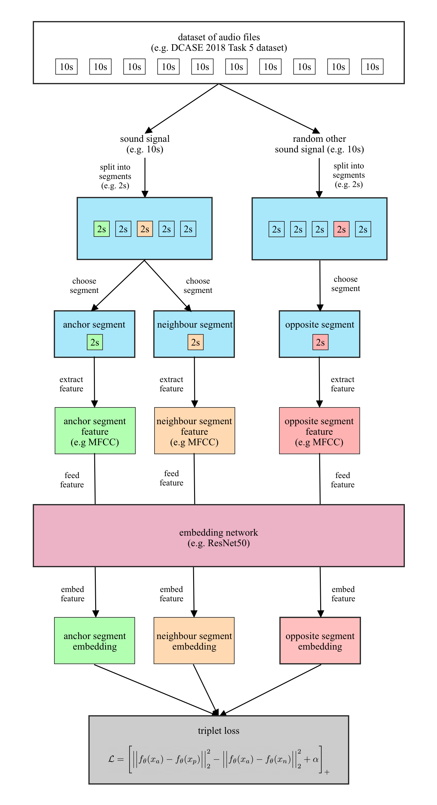
Ideas and concepts
Data pre-processing: None
Feature extraction: Raw waveform, log Mel spectrogram, MFCC
Triplet selection: Songs split into segments, anchor and neighbour belong to the same audio, opposite belongs to a different one (temporal proximity)
Models: state-of-the-art CNN, GRU, CRNN architectures
Application to music: same as for noise detection set
Metrics: Embedding: triplet loss, distance to neighbour and opposite Classifier: sparse categorical cross-entropy loss, sparse categorical accuracy, macro-averaged F1 score
Fig. 14 Input pipeline
Notes:
- Now I want to describe some of my ideas on how to realise and implement the project

Slide 14
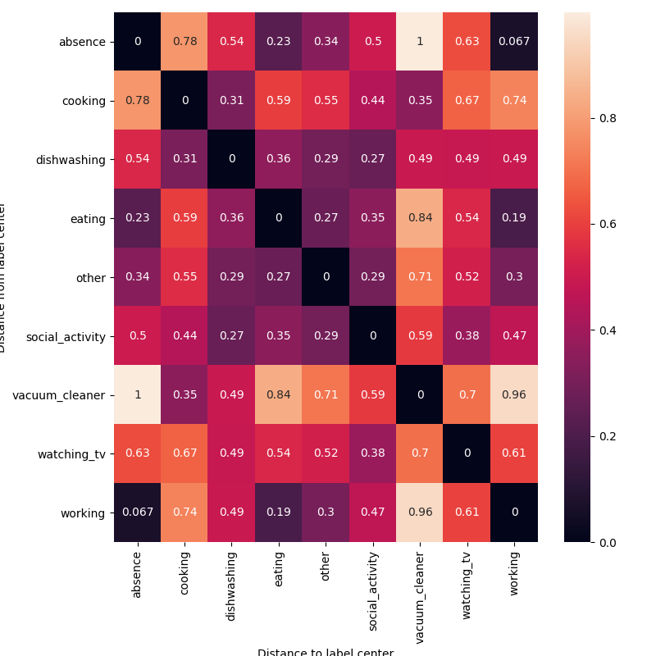
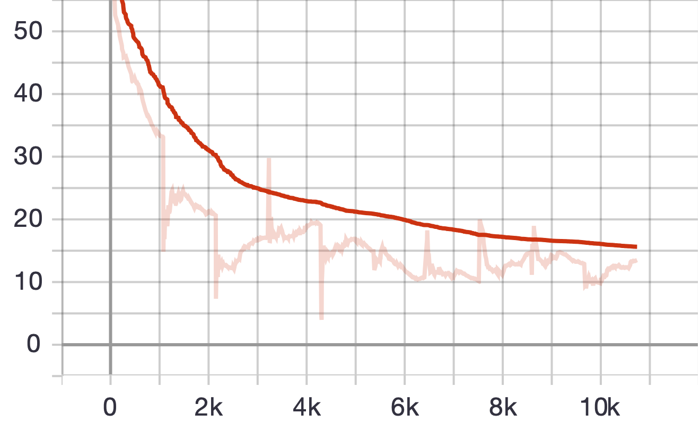
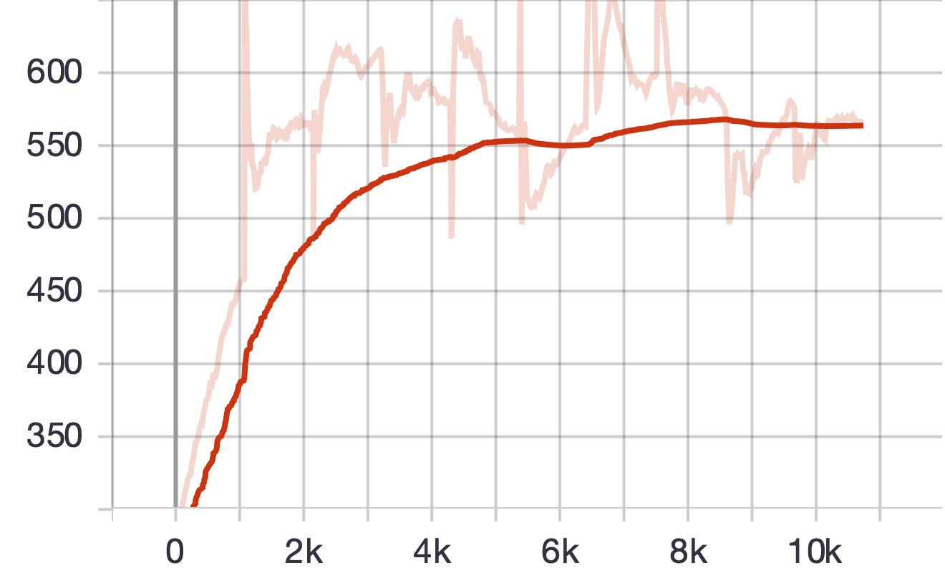
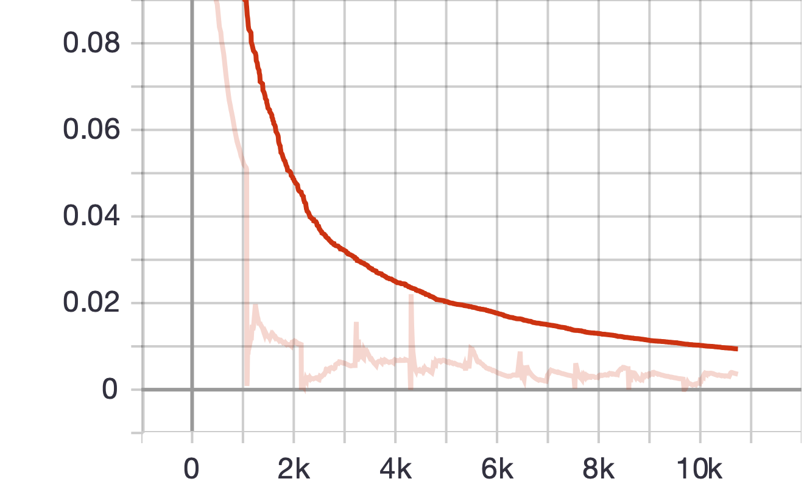
First results: Metrics
Distance neighbour²
Distance opposite²
value
value
batch steps
batch steps
Triplet loss
value
batch steps
Fig. 15 Metrics
Fig. 16 Distance matrix
Notes:
I’d now like to move on to the final part and show you some of my first results
These metrics and visualisations are from a ResNet18 model trained for 10 epochs on the noise detection dataset

Slide 15
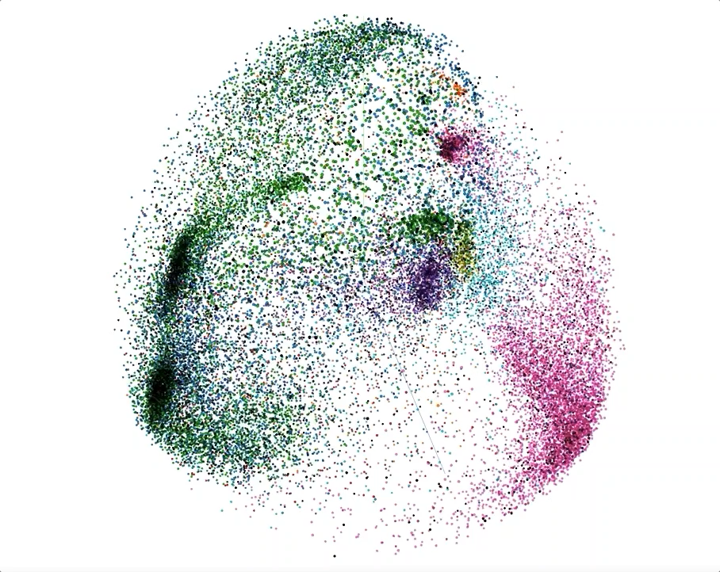
First results: Projection of embeddings
Fig. 17 Visualisation of embedding space
Notes:
Here you can see a visualisation of the resulting embedding space from the model we saw before
It was visualised using the tensorboard projector
Labels are displayed with colors
For dimensionality reduction a PCA with 3 dimensions was used

Slide 16
Summary and Outlook
Summary:
Create an embedding space for audio using an unsupervised triplet loss
Evaluate the embedding space for noise detection and music
Outlook:
Experiment with most suitable audio feature representation
Experiment with state-of-the-art architectures
Apply embedding architecture to music
Hyperparameter tuning for noise and music architecture
Notes:
- To finalise I will summarise briefly what we have looked at today and provide you an outlook on the weeks to come

Slide 17
Questions & Answers
Q & A
Notes:
- Thank you for your attention and I'm happy to answer your questions

Slide 18
References
Introduction to Digital Signal Processing
[1] https://www.allaboutcircuits.com/technical-articles/an-introduction-to-digital-signal-processing/
Fundamentals of Music Processing
[2] Müller, Meinard. Fundamentals of Music Processing. Cham: Springer International Publishing, 2015. https://doi.org/10.1007/978-3-319-21945-5.
Deep Learning
[3] Goodfellow, Ian, Yoshua Bengio, and Aaron Courville. Deep Learning. MIT Press, 2016.
Triplet Loss
[4] https://omoindrot.github.io/triplet-loss
[5] Schroff, Florian, Dmitry Kalenichenko, and James Philbin. “FaceNet: A Unified Embedding for Face Recognition and Clustering.” 2015 IEEE Conference on Computer Vision and Pattern Recognition (CVPR), June 2015, 815–23. https://doi.org/10.1109/CVPR.2015.7298682.

Slide 19
References
Tile2Vec
[6] https://ermongroup.github.io/blog/tile2vec/
[7] Jean, Neal, Sherrie Wang, Anshul Samar, George Azzari, David Lobell, and Stefano Ermon. “Tile2Vec: Unsupervised Representation Learning for Spatially Distributed Data.” ArXiv:1805.02855 [Cs, Stat], May 30, 2018. http://arxiv.org/abs/1805.02855.
DCASE Challenge 2018 Task 5
[8] http://dcase.community/challenge2018/task-monitoring-domestic-activities

Slide 20
Datasets used: DCASE Challenge 2018 – Task 5 dataset
Activity | # 10s segments | # sessions
Absence (nobody present in the room) | 18860 | 42
Cooking | 5124 | 13
Dishwashing | 1424 | 10
Eating | 2308 | 13
Other (present but not doing any relevant activity) | 2060 | 118
Social activity (visit, phone call) | 4944 | 21
Vacuum cleaning | 972 | 9
Watching TV | 18648 | 9
Working (typing, mouse click) | 18644 | 33
Total | 72984 | 268
References: [8]
Notes:
The daily activities for this task are shown in Table along with the available 10s multi-channel segments in the development set and the amount of full sessions of a certain activity (e.g. a cooking session).

Slide 21
Related Work: Machine Learning
Unsupervised Learning: Identify patterns within unlabeled data
Supervised Learning: Approximate function from labeled data
References: [1]
Notes:
Recap the two
Unsupervised -> unknown patterns
Supvervised -> approximate functions from labeled data

Slide 22
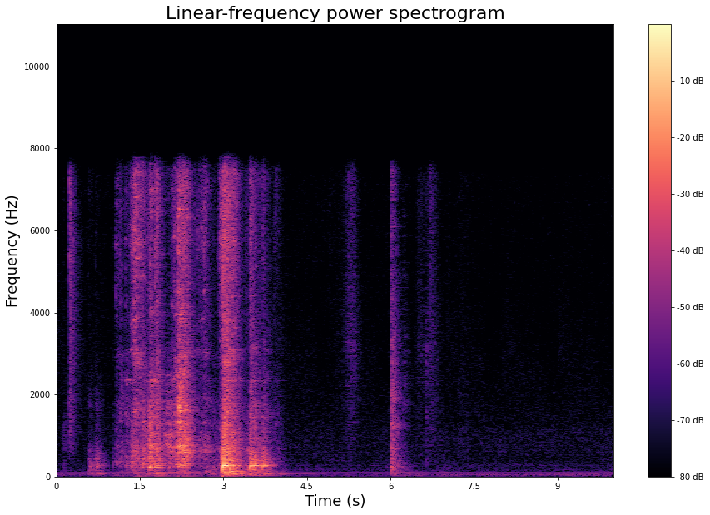
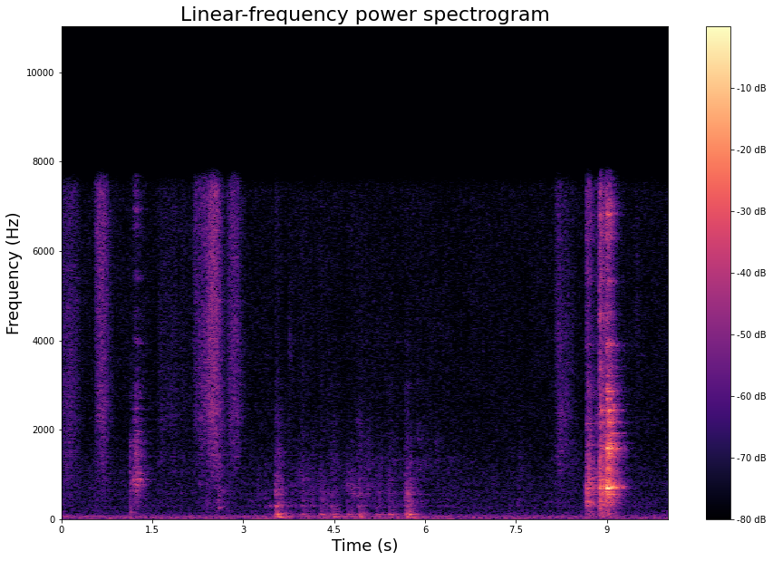
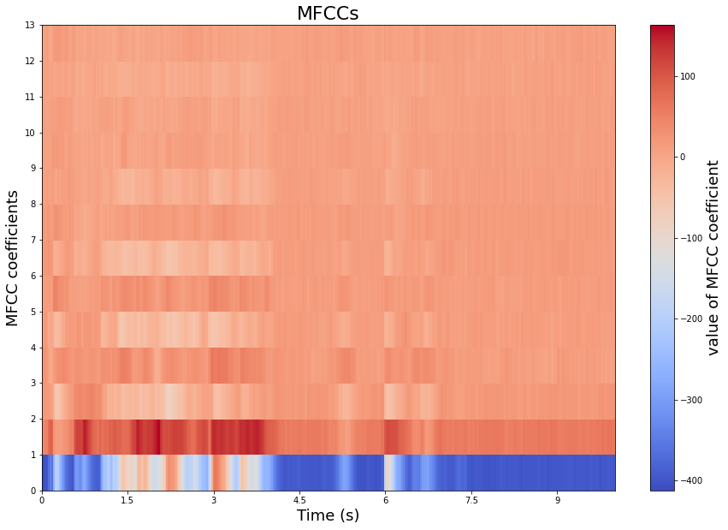
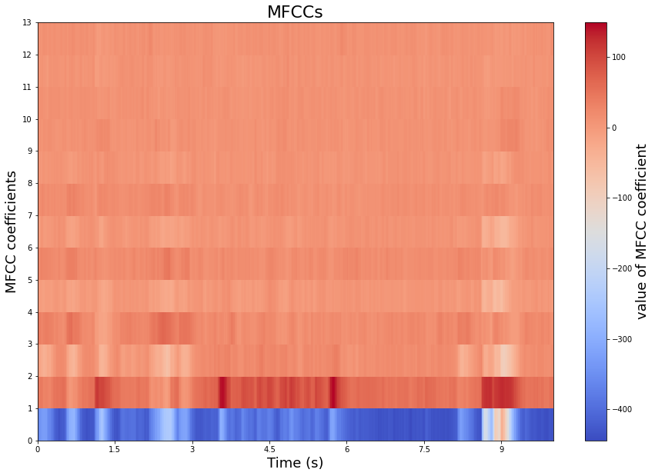

Datasets used: DCASE Challenge 2018 – Task 5 dataset and Music Dataset
Label: cooking
Label: dishwashing
References: [3]

Slide 23
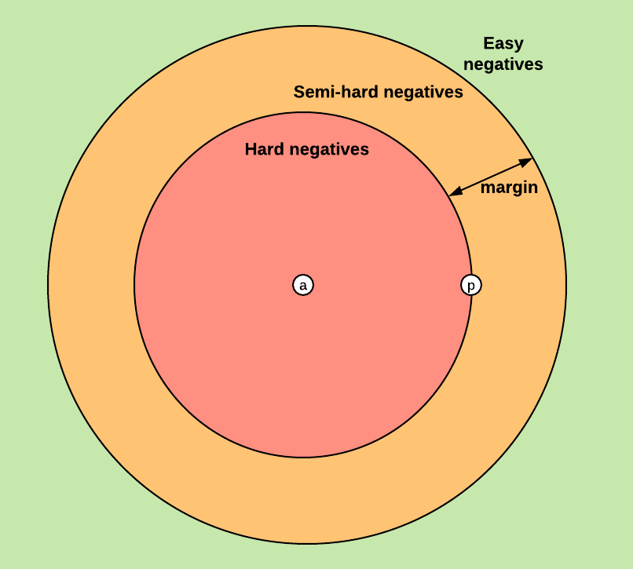
Related Work: Triplet Loss
References: [3]

